Slide 1
Open source hygiene – Mitigating Security Risks from Development, Integration, Distribution and Deployment of Open Source Software
Bill Weinberg, Senior Director, Open Source Strategy, Black Duck Software
RVAsec – June 5, 2015

Slide 2
Presentation abstract
OSS Hygiene – Mitigating Security Risks from Development, Integration, Distribution and Deployment of Open Source Software
Across the landscape of IT, Open Source Software (OSS) is pervasive and ubiquitous. From the cloud and web to data centers; from the desktop to mobile devices; and across a range of embedded and IoT applications, OSS commands an ever-increasing, dominant share of the system software stack and provides equally substantial swathes of enabling application middleware, applications themselves, and tooling.
While rapid adoption of OSS demonstrably offers a range of advantages, the community development model presents developers, integrators and deployers with a set of accompanying challenges related to security, operational, and legal risk. Historically, foremost among these concerns stood license compliance and IP protection; however, with recent highly publicized threats to OSS, security has joined these concerns and today dominates the OSS adoption conversation.
This presentation will explore the role of and requirements for secure development of and deployment with OSS.

Slide 3

Your speaker
Bill Weinberg, Senior Director, Open Source Strategy – Black Duck Software
Bill helps Fortune 1000 clients create sound approaches to enable, build, and deploy software for intelligent devices, enterprise data centers, and cloud infrastructure.
Working with FOSS since 1997, Bill also boasts more than thirty years of experience in embedded and open systems, telecommunications, and enterprise software. As a founding team-member at MontaVista Software, Bill pioneered Linux as leading platform for intelligent and mobile devices. During his tenure as Senior Analyst at OSDL (today, the Linux Foundation), Bill ran Carrier Grade and Mobile Linux initiatives and worked closely with foundation members, analyst firms, and the press. As General Manager of the Linux Phone Standards Forum, he worked tireless to establish standards for mobile telephony middleware.
Bill is also a prolific author and busy speaker on topics spanning global FOSS adoption to real-time computing, IoT, legacy migration, licensing, standardization, telecoms infrastructure, and mobile applications. Learn more at http://www.linuxpundit.com/.

Slide 4
Agenda
Open Source – Present and Future
The Open Source Vulnerability Landscape
The Open Source Development Model
Open Source Hygiene
Q&A
Notes:
Good morning. Today we will be discussing some of the key trends, challenges and considerations in managing Open Source Software. I will present for you an introduction to OSS Logistics – Black Duck’s framework for managing OSS within an organization. We will leave time for questions at the end of the presentation, but please feel free to interrupt me if you have questions as we go along.

Slide 5
Open source is unstoppable
The 2015 Future of Open Source Survey

Slide 6




78% of Companies run on open source
@futureofoss #FutureOSS
Corporate use
LESS THAN 3%
DON’T USE OSS IN ANY WAY
Notes:
Hot off the press: 2015 Future Of Open Source Study results! #futureOSS http://bit.ly/FOOS2015@north_bridge @black_duck_sw

Slide 7

2x
@futureofoss #FutureOSS
Corporate use
USE OF OPEN SOURCE TO RUN
BUSINESS IT ENVIRONMENTS HAS GONE UP
SINCE 2010

Slide 8


Increasing abundance
@futureofoss #FutureOSS
Corporate use
Open Source Projects
Black duck knowledgebase
Source: Black Duck Software

Slide 9






Oss impacts technology
@futureofoss #FutureOSS
technology
CLOUD
BIG DATA
OPERATING SYSTEMS
CONNECTED PRODUCT/IoT
OPEN SOURCE IS SO PERVASIVE THAT ALL SOFTWARE CATEGORIES USE IT OR HAVE DEPENDENCIES ON IT

Slide 10

The SECURITY OF OPEN SOURCE
@futureofoss #FutureOSS
security
46%
give OSS first consideration among security technologies
However,
67%
don’t monitor open source code for security vulnerabilities.
55%
said open source delivers superior security

Slide 11
The open source vulnerability landscape
No worse (actually somewhat better) than other types of software

Slide 12

Worried about open source security?
“Through 2020, security and quality defects
publicly attributed to OSS projects will increase significantly, driven by a growing presence within high-profile, mission-critical and mainstream IT workloads.”
Gartner, Road Map for Open-Source Success: Understanding Quality and Security, Mark Driver, 3 March 2014.

Slide 13
The growth in security vulnerabilities
Based on the National Vulnerability Database published by the National Institute of Standards and Technology (a repository by the U.S. government)

Slide 14



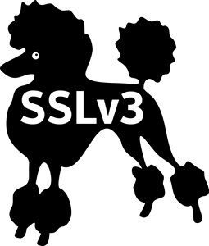

OSS Vulnerability landscape
Of 9,200 security vulnerabilities reported in 2014, 4,000 affected open source code.
– National Vulnerability Database & IBM X-Force
FREAK

Slide 15
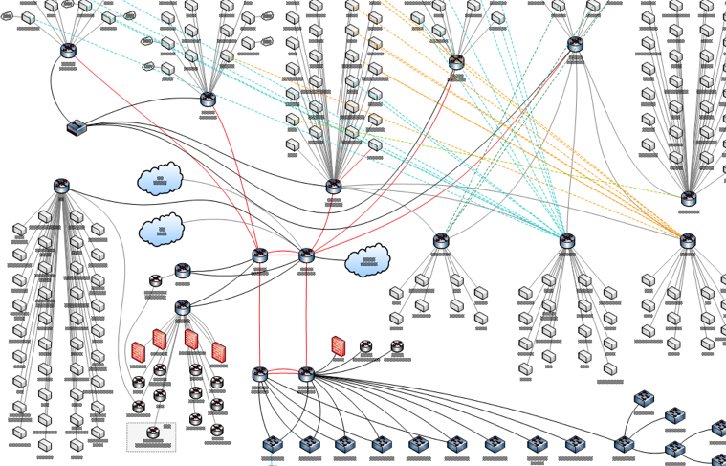
the rise of “named” vulnerabilities in oss

Slide 16
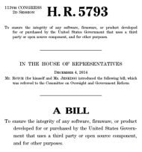

Pending legislation – H.R. 5793 the cyber supply chain transparency and remediation act (“The royce bill”)
3 Key Provisions:
Vendors must provide a Bill of Materials of 3rd-Party and Open Source Components (including versions)
Vendors cannot use known vulnerable components if there is a less vulnerable component available
Software must be patchable/updateable (to address new vulnerabilities when they are discovered)

Slide 17
The open source development model
Inherently (in)secure?

Slide 18



Linus’ Law
Given enough eyeballs, all bugs are shallow
Notes:
“Every motivation that makes a person do something can be classified under "survival", "social life" or "entertainment”. As a result, progress is defined as reaching a higher category; that is, not doing a thing merely for survival, but for social reasons, and then, even better, just for fun – Linus Torlvald, The Hacker Ethic and the Spirit of the Information Ag

Slide 19
Open Source development model
User Community & Ecosystem
Developer Community
Core Developers
Code
Core project developers create, maintain, curate code base
Vet contributions from larger communities
Focus on project goals – features, performance, etc.

Slide 20

Open Source code curation model
User Community & Ecosystem
Developer Community
Core Developers
Feature Reqs
New Features
Vulnerabilities
Patches
Bug Reports
Bug Fixes
Code v1
Code v2
Code vN
CONTINUOUS INCREMENTAL IMPROVEMENT

Slide 21
Open source code quality assurance
COMMUNITY
CODE
Linus’ Law
unterminated strings
Indices out of bounds
memory leaks
back doors
stray pointers
parameter reversal
privilege violations
priority inversion
unitialized variables
race conditions
debug code
deprecated versions
Maintainers, developers, users exercise, debug & improve code
faulty logic
regressions
misconfiguration
incorrect permissions
improper type casts
unchecked function returns

Slide 22


Theoretical “Triple fence” of oss security
Contributions
Faulty Code
Production
Code
Bug Fixes
Malicious Code
Enterprise / OEM Integration
Distribution / Platform Creation
OSS Project Purview

Slide 23

Open source code SECURITY GAP
Majority of eyes occupied elsewhere
Minority of community is security-savvy
COMMUNITY
CODE
unterminated strings
Indices out of bounds
memory leaks
back doors
stray pointers
parameter reversal
privilege violations
priority inversion
unitialized variables
race conditions
debug code
deprecated versions
faulty logic
regressions
misconfiguration
incorrect permissions
improper type casts
unchecked function returns

Slide 24
Threats resistant to community oversight
Use-case specific errors
Local misconfiguration
LAN-based vulnerabilities
Deployed deprecated s/w versions
Weak encryption
Bad authentication
Stolen credentials
Viruses, Trojans & other malware
Denial of service attacks
Weak passwords
Unenforced security policy
Phishing
Man-in-the-middle attacks
Forged certificates
Spoofed MACs and IP addresses
Latent zero-day exploits
Brute force decryption

Slide 25
Open source hygiene
Component-level best practices for securing open source software

Slide 26
Hygiene?
hy·giene /ˈhīˌjēn/ [‘hai dji:n]
conditions or practices conducive to maintaining health and preventing disease, especially through cleanliness.
synonyms: cleanliness, sanitation, sterility, purity, disinfection

Slide 27


Open Source Hygiene?

Slide 28

Open Source Hygiene is the practice of cross referencing the open source content of a company or product software stack, module by module, version by version, with databases of known vulnerabilities of those software components.

Slide 29
Security Technologies – where does oss hygiene fit?
Intrusion
Detection
Authentication
Network
Security
Encryption
End-point
Security
Code Quality
Tools
Patch/Update
Management
Auditing
& Logging
Hardware
Mechanisms
Configuration
Management
Policy
Enforcement
Physical
Security
Formal
Verification
Certifiable
Systems
Capabilities &
Access Control
Binary
Obfuscation

Slide 30
OSS Hygiene - Vulnerability detection and remediation
Intrusion
Detection
Authentication
Network
Security
Encryption
End-point
Security
Code Quality
Tools
Patch/Update
Management
Auditing
& Logging
Open
Source
Hygiene
Hardware
Mechanisms
Configuration
Management
Policy
Enforcement
Physical
Security
Formal
Verification
Certifiable
Systems
Capabilities &
Access Control
Binary
Obfuscation
Notes:
Code Quality Tools
Over half of all vulnerabilities come from basic programming errors and s/w faults
Black Duck OSS security participates in code quality by highlighting need to update to newer, higher-quality versions of OSS projects
Patch / Update Management
Modern enterprise and embedded systems and applications include field update capabilities
Black Duck OSS security helps OEMs, SPs and end-users integrate the latest and most secure versions of OSS technologies in patch sets and updates
Configuration Management
- Many vulnerabilities and exploits leverage poorly configured systems and applications
Black Duck OSS security helps integrators and others ensure that current configurations include the most up-to-date OSS s/w components
Policy Enforcement
Security policy extends from production systems back to development and build
Black Duck OSS security ensures that only policy-compliant versions of OSS components are integrated into production software

Slide 31


Yet another security technology term
Software Composition Analysis (SCA)

Slide 32




Versions and Vulnerabilities
Newer = More Secure
Component
Version
Component
Version
& Exploits
Component
Version
Vulnerabilities
Component
Version
Component
Version
BOM

Slide 33





Example enterprise software build (CI) workflow
6. Build
Results
3. Resolve
Dependen- cies
Artifact Repository
Developer
1. Request Build
4. Perform Build
5. Publish Artifacts,
Build Metadata
2. Fetch
Sources
Source Code
Notes:
walkthrough of Build Flow diagram
which factors are most important to T.Rowe Price in choosing a build automation platform?

Slide 34
Example enterprise software build (CI) workflow
OSS
6. Build
Results
3. Resolve
Dependen- cies
Artifact Repository
Developer
1. Request Build
4. Perform Build
5. Publish Artifacts,
Build Metadata
2. Fetch
Sources
Source Code
Notes:
walkthrough of Build Flow diagram
which factors are most important to T.Rowe Price in choosing a build automation platform?

Slide 35
OSS Hygiene complements security testing
SOFTWARE DEVELOPMENT LIFE-CYCLE
ANALYZE
DESIGN
CODE
TEST
MAINTAIN
Rule-based Vulnerability Testing
Penetration
Testing
Dynamic
Analysis
Static Analysis
RELEASE
OPEN SOURCE HYGIENE
OSS POLICIES
OSS SELECTION
OSS DETECTION
OSS ALERTING
OSS MONITORING
Notes:
This slide demonstrates that BDS can be used across all stages of the SDL, including after release w/o additional testing, while other testing tools are limited to specific phases of the SDL The next slide shows details

Slide 36
OSS Hygiene challenges
Technical
Vulnerability db schemas
Integration in workflows
Build tools, manifests
Scan cycle time/speed
100s build/day
DevOps
Comprehensive scanning
Sheer volume
Repo locations
Language support
Modified OSS & snippets
Missing versioning
Source and Binary
Social / Managerial
OSS management policy
“Organic” OSS selection, ingress and integration
Industry norms
Can’t/won’t remediate
Architecture issues
Version dependencies
Using forked versions
Warning fatigue
Hundreds or thousands of OSS components

Slide 37
Remediation times by industry
Source: NopSec
Days to remediate
Extenuating Factors
Regulated/Unregulated (cuts both ways)
Dependence on CVSS in triage (simplistic / misleading)
Impact of social media (Tweets correlate with exploits)

Slide 38
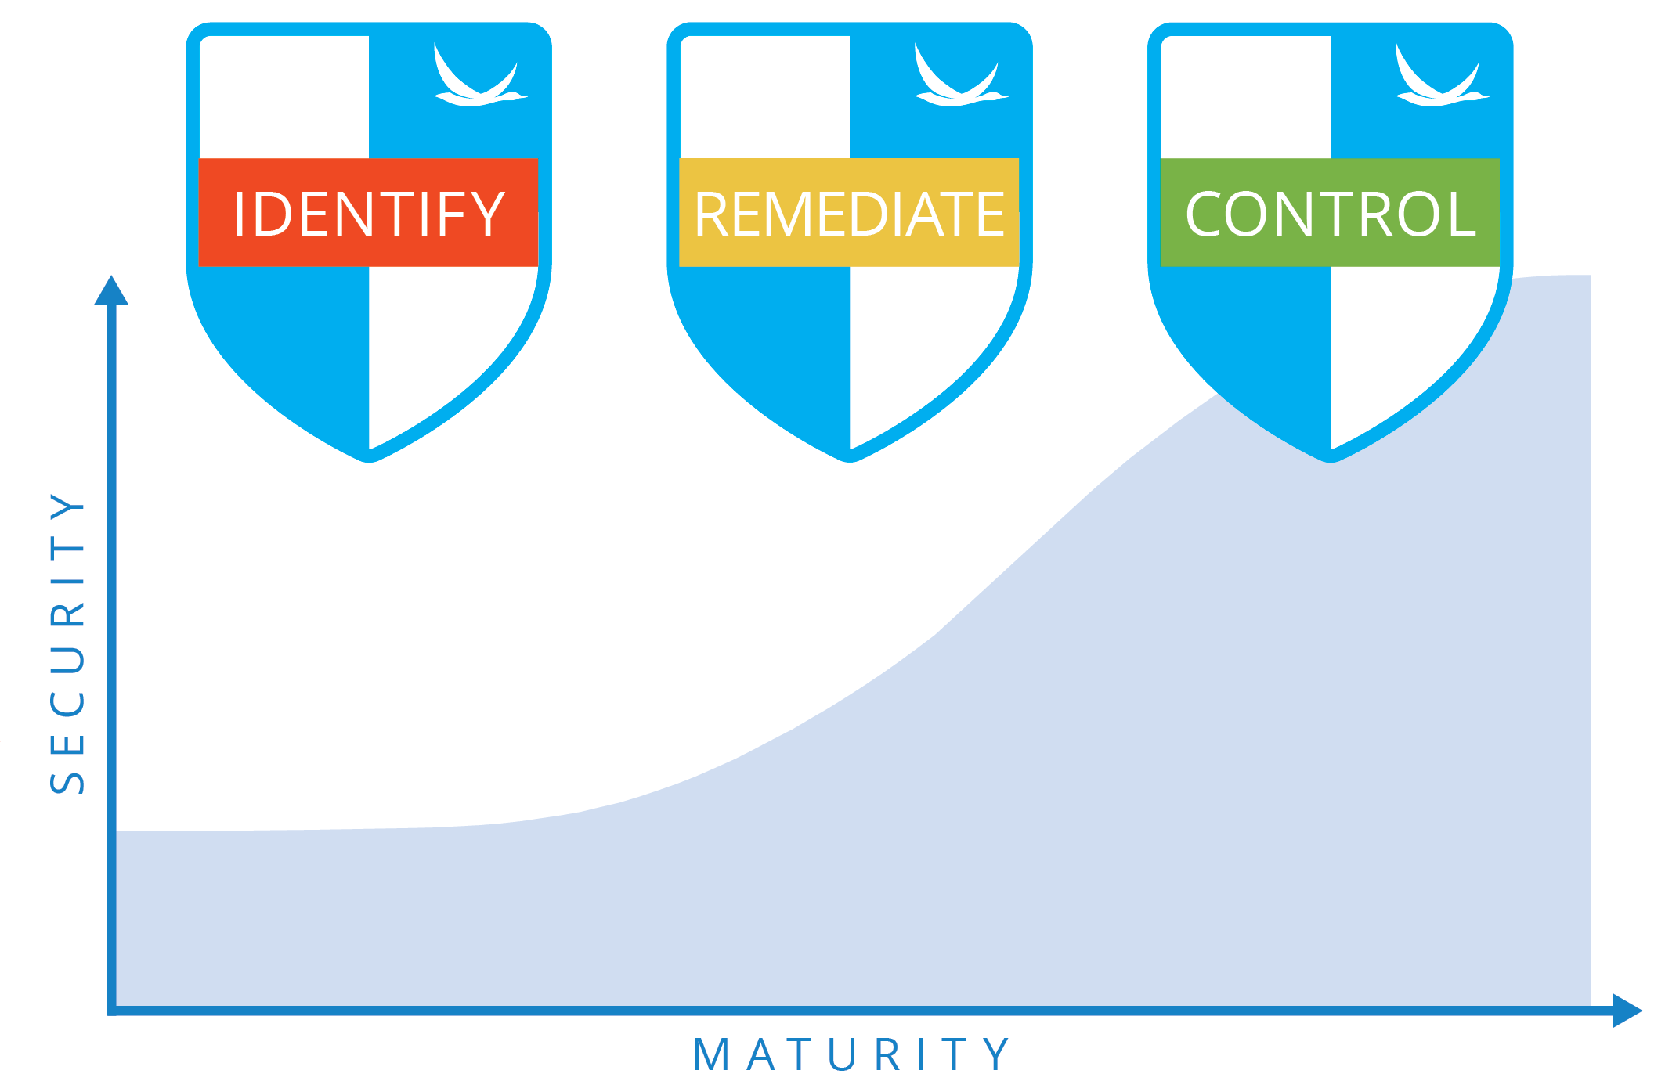
The Road to Secure OSS Use – best practices
Identify OSS in use
Map known vulnerabilities
ID and assess risk
Monitor for new vulnerabilities
Review vuln details
Assess CVE impact
Rank / tier app risk
Triage and develop remediation plan
Track remediation
Inventory & track usage
Configure risk policies and actions
Determine approval request workflow and management
Notes:
Identify the open source code your company has in use. Before you can begin remediating vulnerabilities, you have to gather and maintain a knowledge of what components you have in use and where. Automated code scanning tools that produce a software BoM or “Bill of Materials” – i.e. a listing of open source components and versions contained in an application – are the best approach for organizations seeking a thorough evaluation of their code bases.
Discover known vulnerabilities present in your open source code. There are resources, like the U.S. Government’s National Vulnerability Database (NVD), that track and publically report on security vulnerabilities for all types of software. Yet, more comprehensive and timely notifications can be provided through automated tools that can map vulnerabilities from sources like the NVD and VulnDB, directly to the code your company is using in its applications via the BoM.
Assess and remediate components with vulnerabilities. Every organization is going to have a different approach to assessing potential threats and determining those that require immediate remediation. Developing a triage model can help security teams quickly prioritize vulnerabilities based on criteria such as the severity or exploitability of the vulnerability in conjunction with the sensitivity of the applications impacted.
Monitor for new vulnerabilities. A security professional’s work is never done. Once a vulnerability is quickly and properly patched and remediated, another is likely on the horizon posing a potentially more damaging threat. Continuous, automated scans of applications under development can identify open source entering the code base and ensure that vulnerabilities aren’t being unknowingly introduced along with it. In addition, by monitoring for newly disclosed vulnerabilities and having the ability to immediately assess their impact across your code base will help your company’s security, compliance, and development teams gain peace of mind knowing they are actively managing security threats.

Slide 39
OSS Remediation / Triage considerations
Comparable to other types of software
Severity of vulnerability (CVSS and other rankings)
Number of vulnerabilities / component
Existence/availability of exploits (if known)
Context of vulnerability (internet/customer facing vs. internal)
Availability of patches or other remediation
Existence of comparable functionality in alternate OSS tech
Willingness / capability to patch / maintain OSS forks

Slide 40


OSS Hygiene – the need for automation
 | Manual Procedure | Automated Process
Speed | Slow | Faster
Timeliness | Seldom | Automatic
Accuracy | Low | High
Comprehensiveness | With Difficulty | Configurable
Latency | Weeks / Months | Hours
Workflow Impact | Disruptive | Transparent
Repeatable / Traceable | Almost Never | Always
Remediation | Subjective | Policy-based
Cost | FTEs | CapEx / OpEx

Slide 41
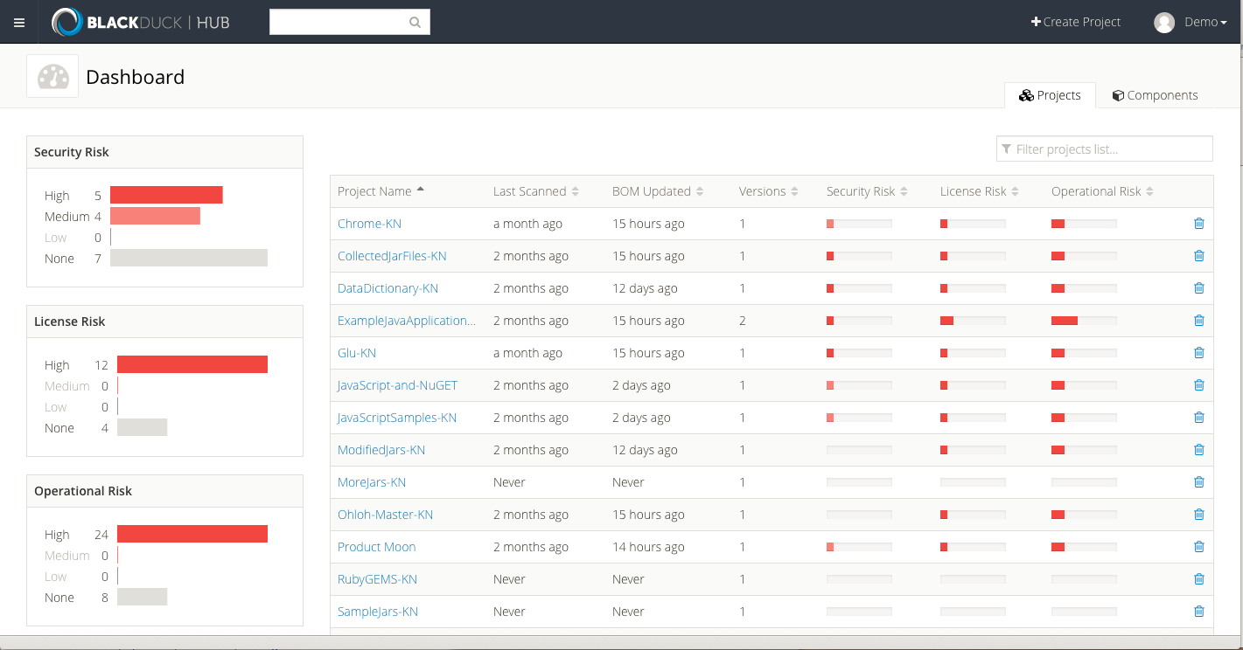
Identify Vulnerabilities in OSS Software portfolioS
Scan code to automatically identify open source in use
Map known security vulnerabilities
Assess licenses, versions, community activity (operational risk)
Identify open source in use with potential high-risk

Slide 42
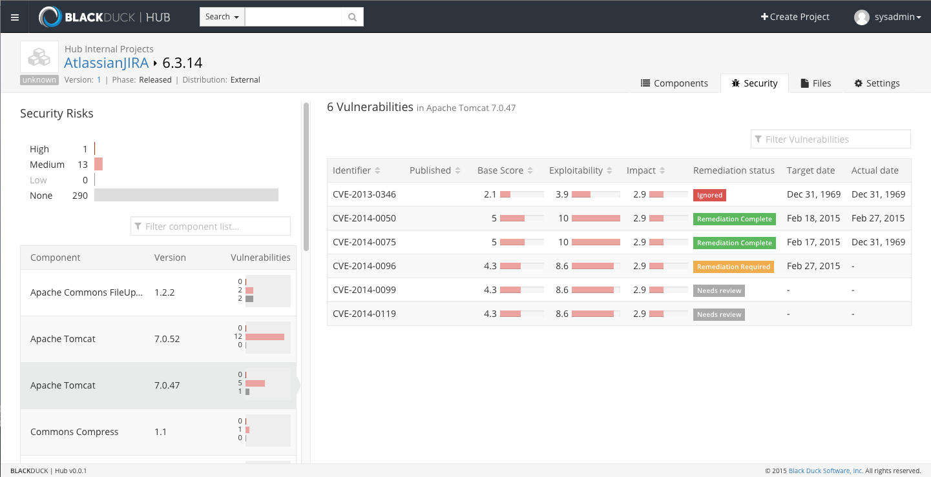
Remediation dashboards
Review CVSS and its impact on each project
Assess, triage and prioritize vulnerabilities
Schedule and track planned and actual remediation dates

Slide 43
OSS Hygiene – pros and cons
Benefits
Brings OSS components up to date
Breaks open 3rd party code box
Also fights version proliferation
Limitations
Only effective as current version / patch set
Effective for OSS only
Primary focus on source code (cf. BAT)

Slide 44
conclusion
OSS Hygiene addresses a critical function in application security
Focus on version deprecation as a source of vulnerabilities
Streamlines identification and remediation of exploitable OSS components
OSS Hygiene is NOT
Source code analysis tool or method (it uses community resources)
A replacement for other security tools (it complements them)
A marketing gimmick (real organizations present real requirements)
OSS Hygiene is an actionable methodology
Can be implemented manually and/or with tools/mechanisms in place
Benefits from fast and accurate scanning of software portfolios
Best when employed as part of disciplined OSS management practices

Slide 45

Conclusions and Q&A

